Slide 1
HP Retail Solutions
Tanmay Dubey
Category Lead for Virtualization and Retail Solutions

Slide 2
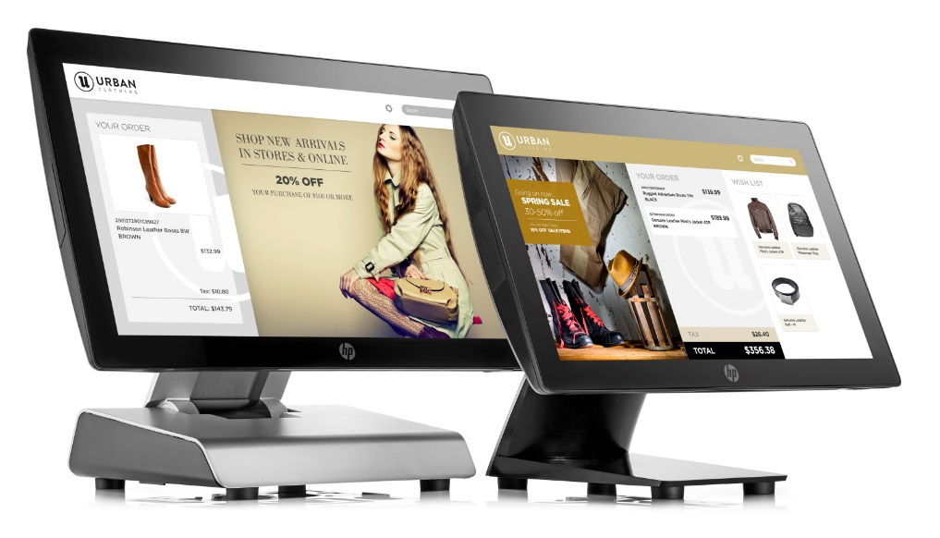
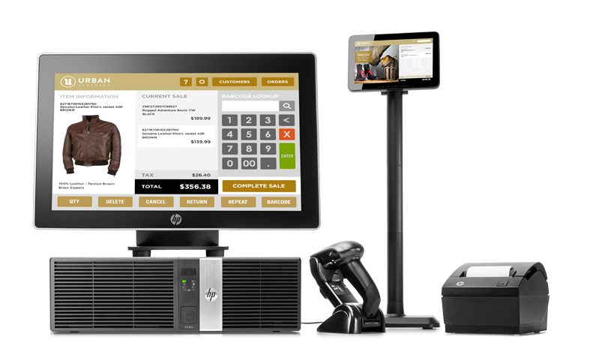
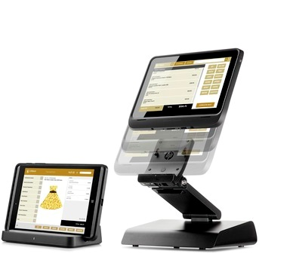
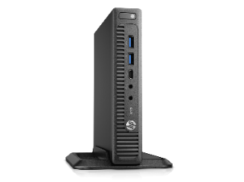
From traditional to mobile, HP is reinventing the customer experience with technology solutions that empower employees and engage customers

Slide 3
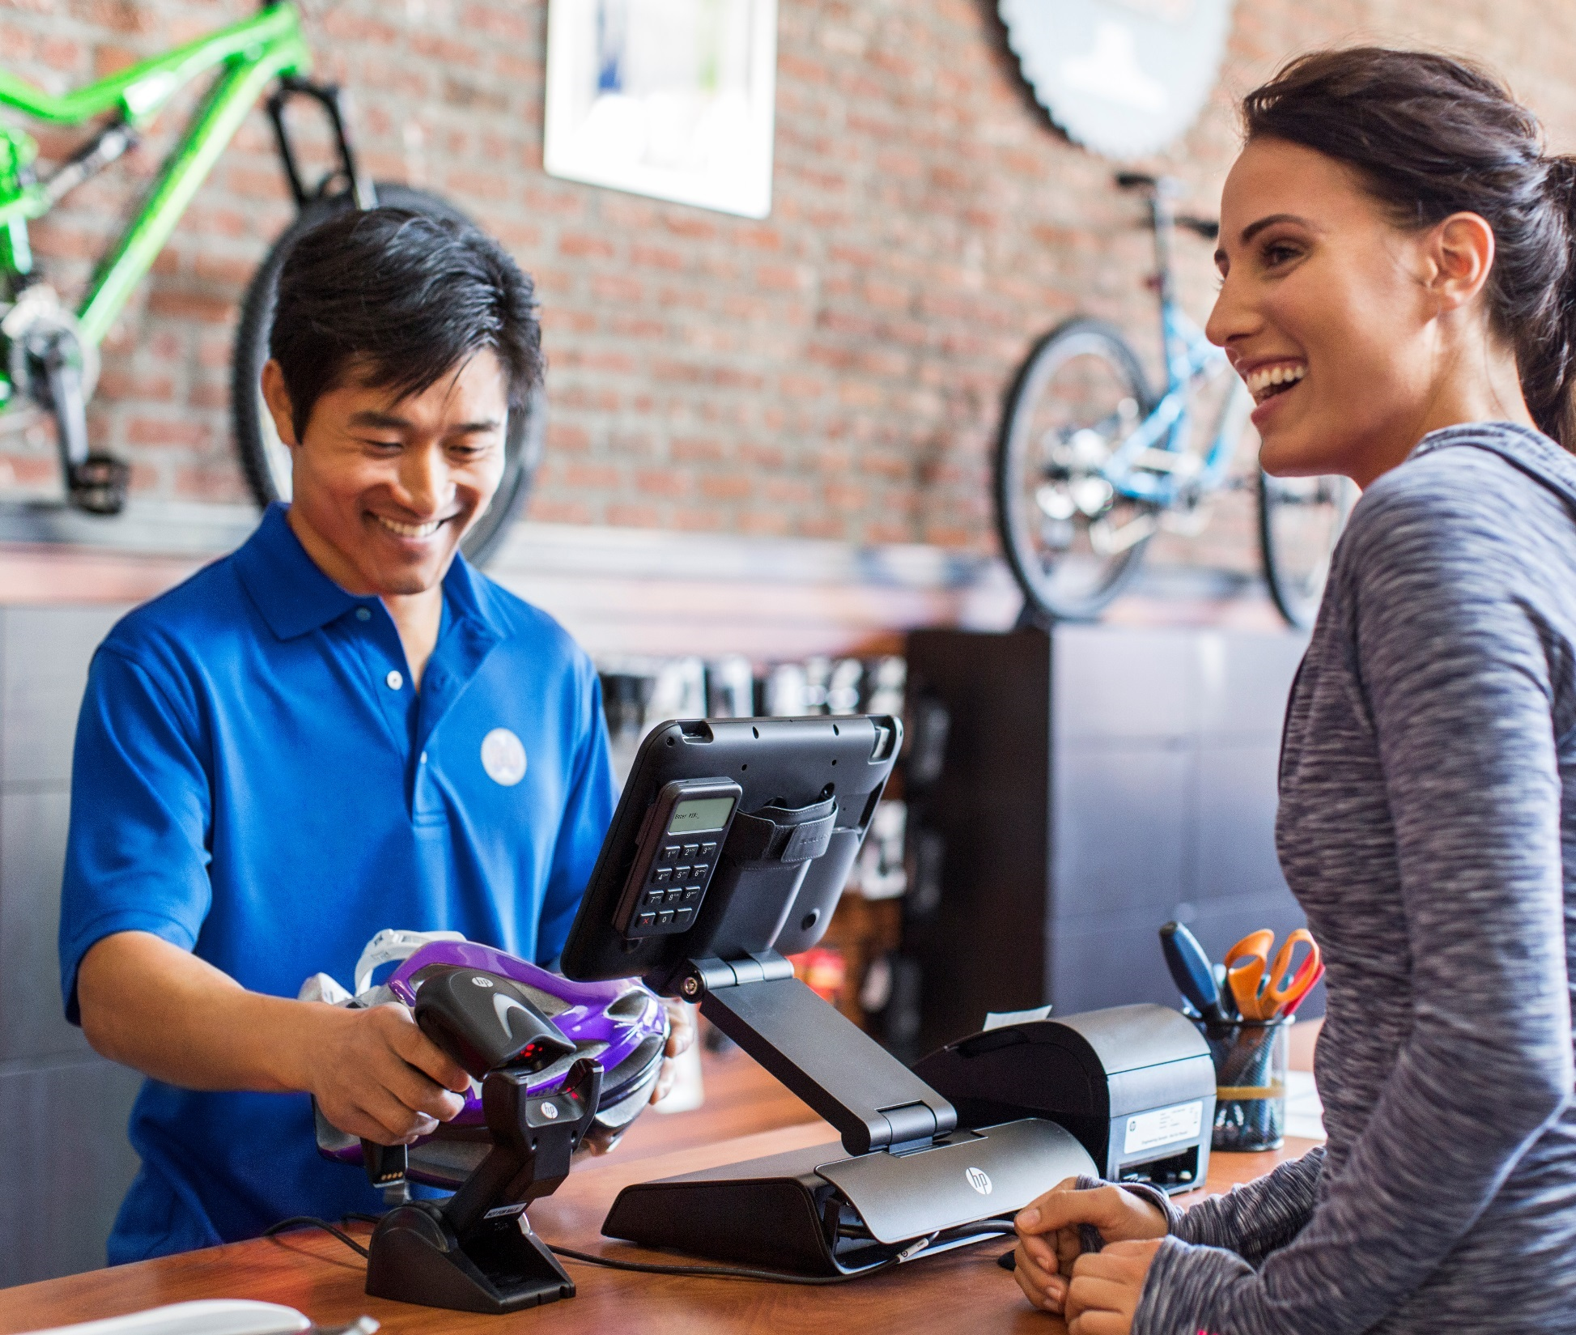
Who is HP in Retail?
Retail Solutions Business Unit provides:
Traditional point-of sale platforms and accessories
Modular platforms
All-in-one platforms
Point-of-sale accessories
Mobility solutions
8in and 12in tablet solutions
Increasing Market Growth:
#2 position Worldwide POS Market Share
Notes:
#2 position Worldwide POS Market Share (Source: IHL Report 2015-Q4 Worldwide Quarterly POS Shipments by Vendor)
Based on its current positioning, we see that HP has the strongest growth opportunities out of all the competitors examined. As it is focusing on in-store systems without marketing its own application software platform, it can be seen as the partner of choice for independent software vendors. It has also already developed the most compelling proposition in the growing in-store mobility segment and benefits from economies of scales in its POS business, which will allow the company to better cope with downward price pressure in this market segment. Source: Planet Retail, July 2015

Slide 4
We enable retailers to empower their employees and engage their customers with:
Breadth of portfolio that meets the unique needs of retailers both large and small.
Best-in-class products leveraging our world class supply chain and volume to lower cost and drive leading edge technology.
Innovation and thought leadership delivered through HP labs.
Flexibility that allows you to standardize on one retail platform across the store from the sales floor to the back office
Award winning, consumer-centric hardware designs that are intuitive to use, yet designed for maximum performance and reliability.
Partners of choice (ISVs & Resellers) to provide best-in-class solutions
Outstanding warranty and care pack offerings and round the clock support to extend the useful life of our solutions.

Slide 5
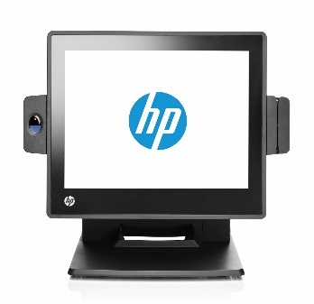
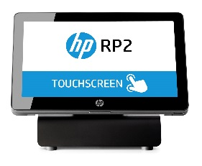
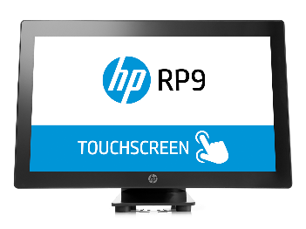
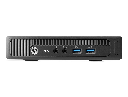
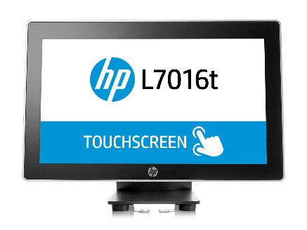
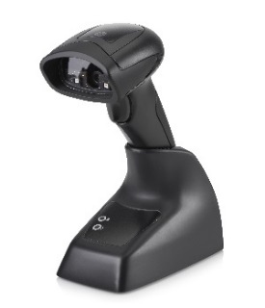
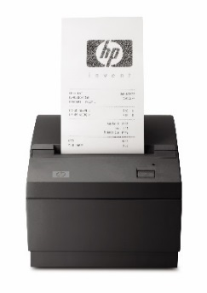
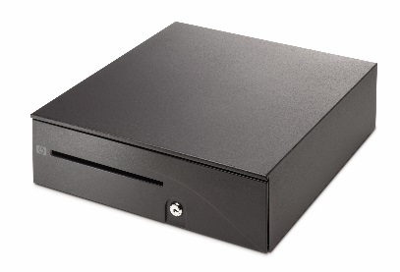
HP traditional Retail Solutions portfolio
All-in-One systems
Modular systems
RP2
Value All-in-One
Intel Quad-Core Processors
IP-54 rated, fan-less design
RP7
Performance All-in-One
Versatile, sleek-design
Fan-based design
RP9
Performance All-in-One
Versatile, sleek-design
Fan-based design
MP9
Small form factor
Multi-purpose platform
Flexible mounting locations
RP5
Performance module system
Multi-purpose platform
Extensive connectivity and configuration options
Retail Peripherals
Notes:
Peripheral notes:
Select from a full suite of HP peripherals to accommodate unique requirements
Provide efficient checkout experiences by reducing transaction times
Designed with robust features and long life expectancies suited for retail environments
Industry-standard 32/64 bit drivers (OPOS/JPOS) and HP platform testing
Backed by HP’s 3-year Limited Warranty, plus service options to extend or enhance support
Most Important POS upgrade features: (Source: EKN 2015 Retail Point-of-Sale Blueprint Study)
Data Security Compliance
Ease of integration
Ease of use/user interface
Ease of future updgrades

Slide 6
Key HP Retail and Hospitality Customers
Notes:
McDonalds
Publix
Disney
Price Chopper
Shoprite
CVS
Home Depot
Fed Ex
GameStop
AutoZone
Advanced Auto
Sally Beauty
Leroy Merlin
L’Oreal
VF

Slide 7
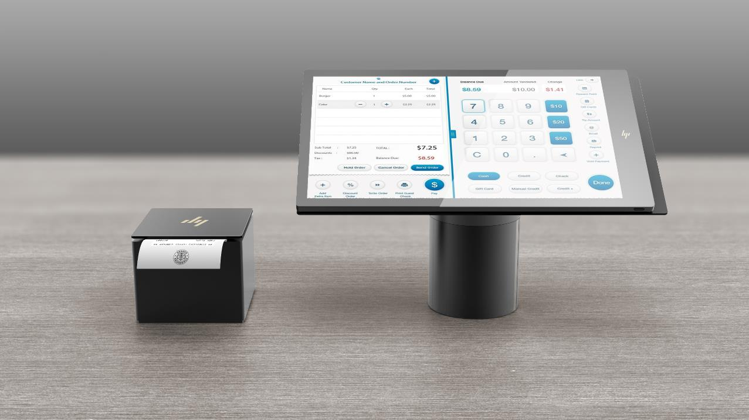
Peripheral Ecosystem – Innovative Printer Design
Standalone companion printer
Integrated column printer
HP Confidential. For use under Confidential Disclosure Agreement only. © Copyright 2017 HP Inc. The information contained herein is subject to change without notice.
Notes:
114mm (4.5”) per second print speed
1 million knife cut rating (1 receipt every 2 minutes, 24x365 for 5 years)
Standalone printer offers ~2x more linear printing
I/O:
Column printer: 24V PUSB or USB + Pwr brick
Standalone printer: Serial/USB + Pwr brick

Slide 8
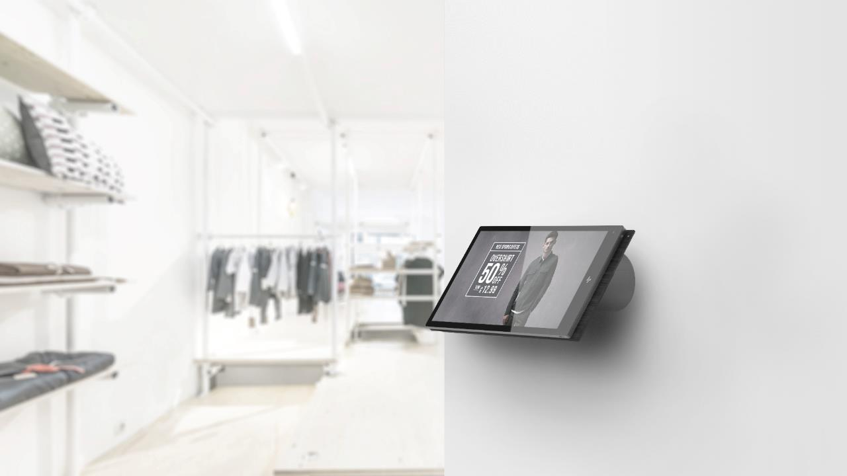
Extends beyond POS
Interactive Signage
Self-Service
Time & Attendance
HP Confidential. For use under Confidential Disclosure Agreement only. © Copyright 2017 HP Inc. The information contained herein is subject to change without notice.
Notes:
Nantucket’s component ecosystem offers maximum versatility to define a storefront with the functionality a retailer needs
Make a statement by displaying Nantucket to promote your product or service as an interactive signage device
Retain Nantucket as a point of engagement to take surveys or gather information from your customer base
Customers won’t lose site of the product – retail and hospitality operators can use Nantucket as a way-finder
Bust the lines by operating Nantucket as a self – service point of sale
Represent yourself as the host with the most with employing Nantucket as the concierge point of service
Keep employees on track with Nantucket as an employee timeclock

Slide 9
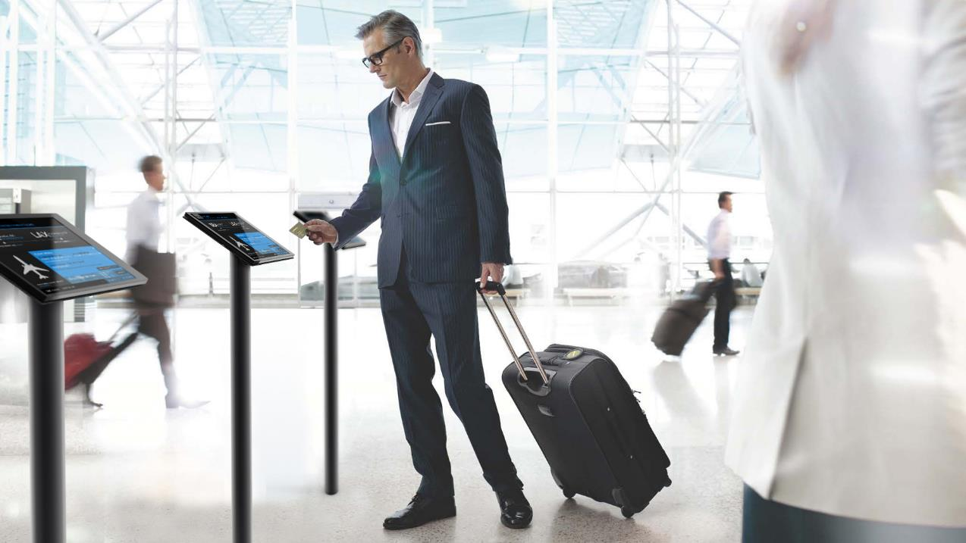
Extends beyond POS
HP Confidential. For use under Confidential Disclosure Agreement only. © Copyright 2017 HP Inc. The information contained herein is subject to change without notice.
Notes:
This image depicts an elegant self- service solution.

Slide 10
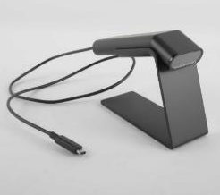
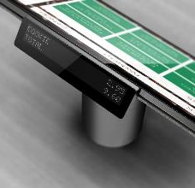
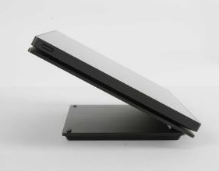
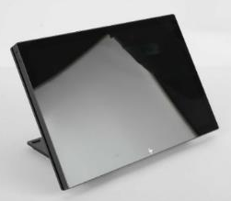
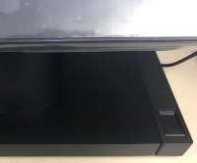
Ecosystem – ElitePOS Peripherals Family
Column Printer
Standalone Printer
2D Barcode Scanner
2x20 Customer Display
10” Touch & Non-Touch Customer Displays
Magnetic Stripe Reader
Biometric Fingerprint Reader
HP Confidential. For use under Confidential Disclosure Agreement only. © Copyright 2017 HP Inc. The information contained herein is subject to change without notice.
Notes:
The ecosystem maximizes productivity by providing HP peripherals with complementary designs that integrate seamlessly and provides a clean counter environment.
Choice of an integrated column or standalone receipt printers
Standalone Barcode Scanner with a matching, sleek stand is ideal for mobile wallets and digital coupons that scans 1D and 2D bar codes
The Magnetic Stripe Reader is fully integrated into the display head for a clean, functional feel. Single-head, bi-directional and Encryption capable for built in security
The sleek biometric fingerprint reader provides authentication and be configured next to stand or as a standalone reader
Smallest, thinnest HP 2x20 display supports both complex and non-complex characters, with the ability to change background and font to suit your storefront design
10” Touch & Non-Touch customer facing displays provide an elegant way to interact with customers

